Slide 1
Use Autofilter to Find Peak Area
Qiang Fu
02202007

Slide 2
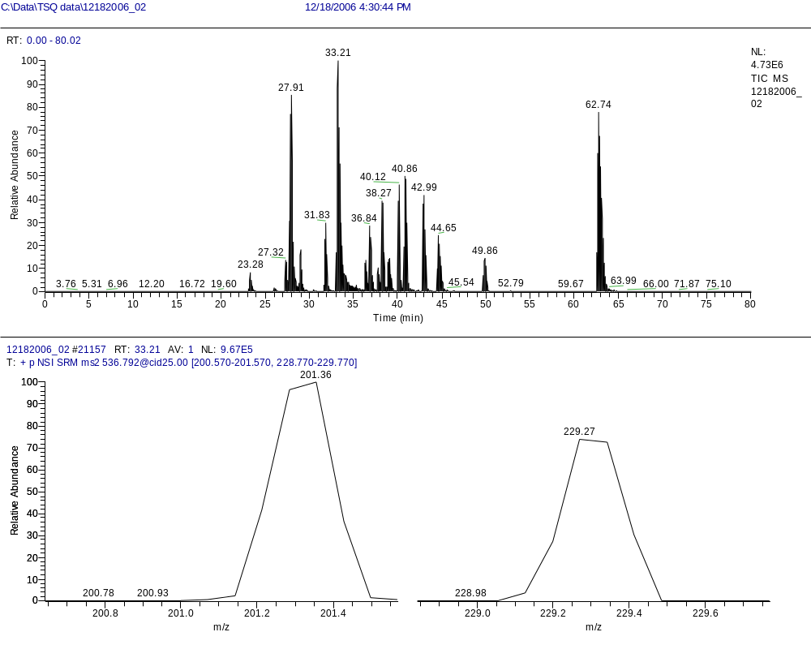
The Peak at 33.21min

Slide 3
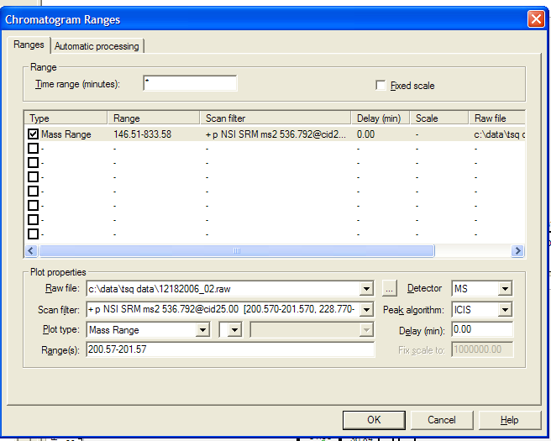
Mass Range is needed to select on SRM

Slide 4
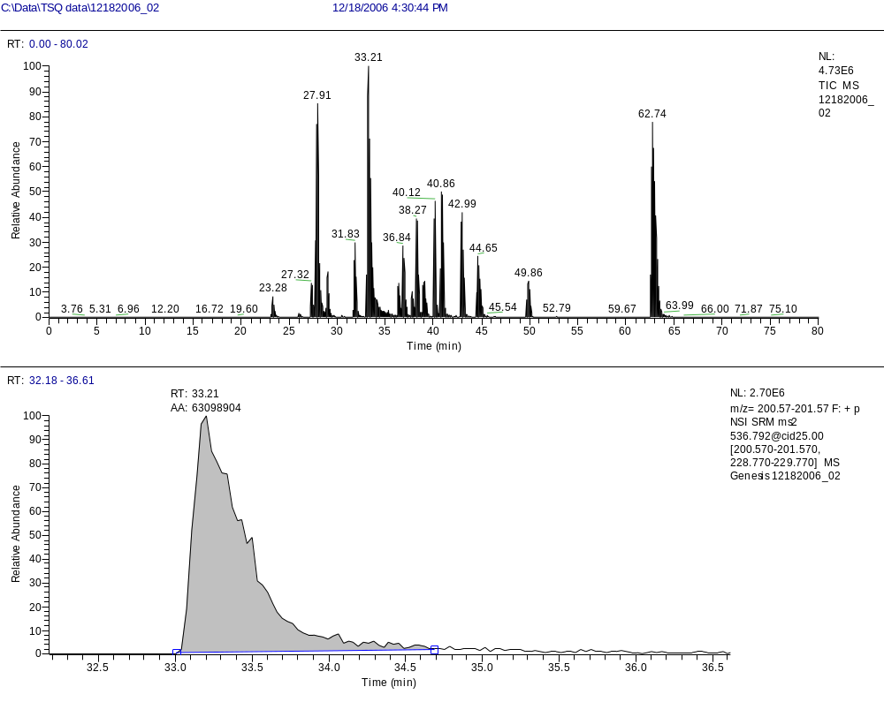

Slide 5
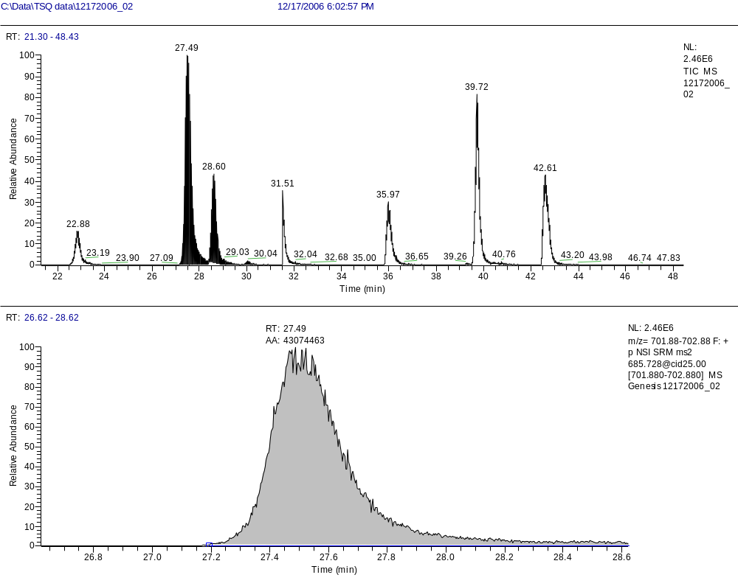
Another Example
AA:43074463 NL:2.46e6

Slide 6
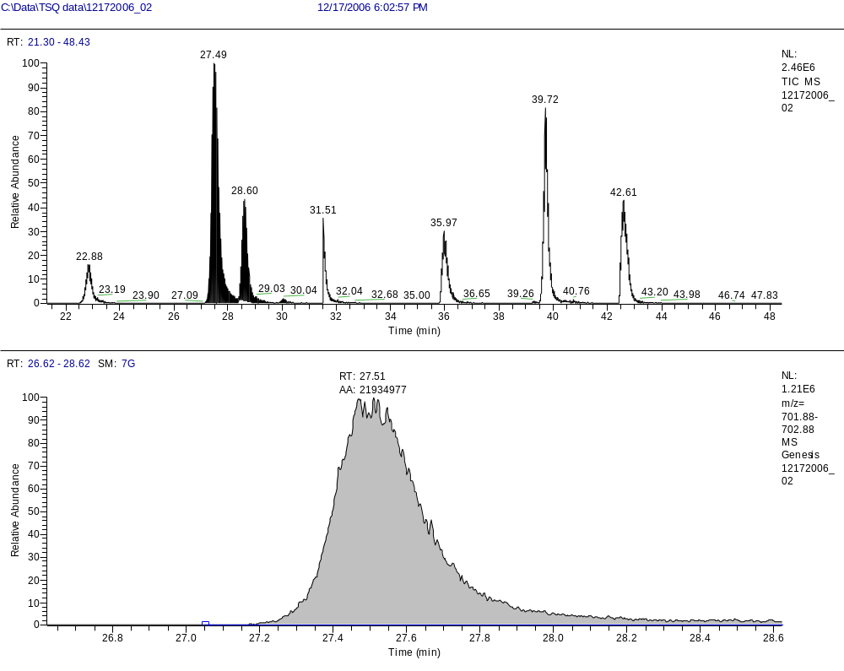
Use Gaussian Smoothing
AA:21934977 NL:1.21e6

